Slide 1
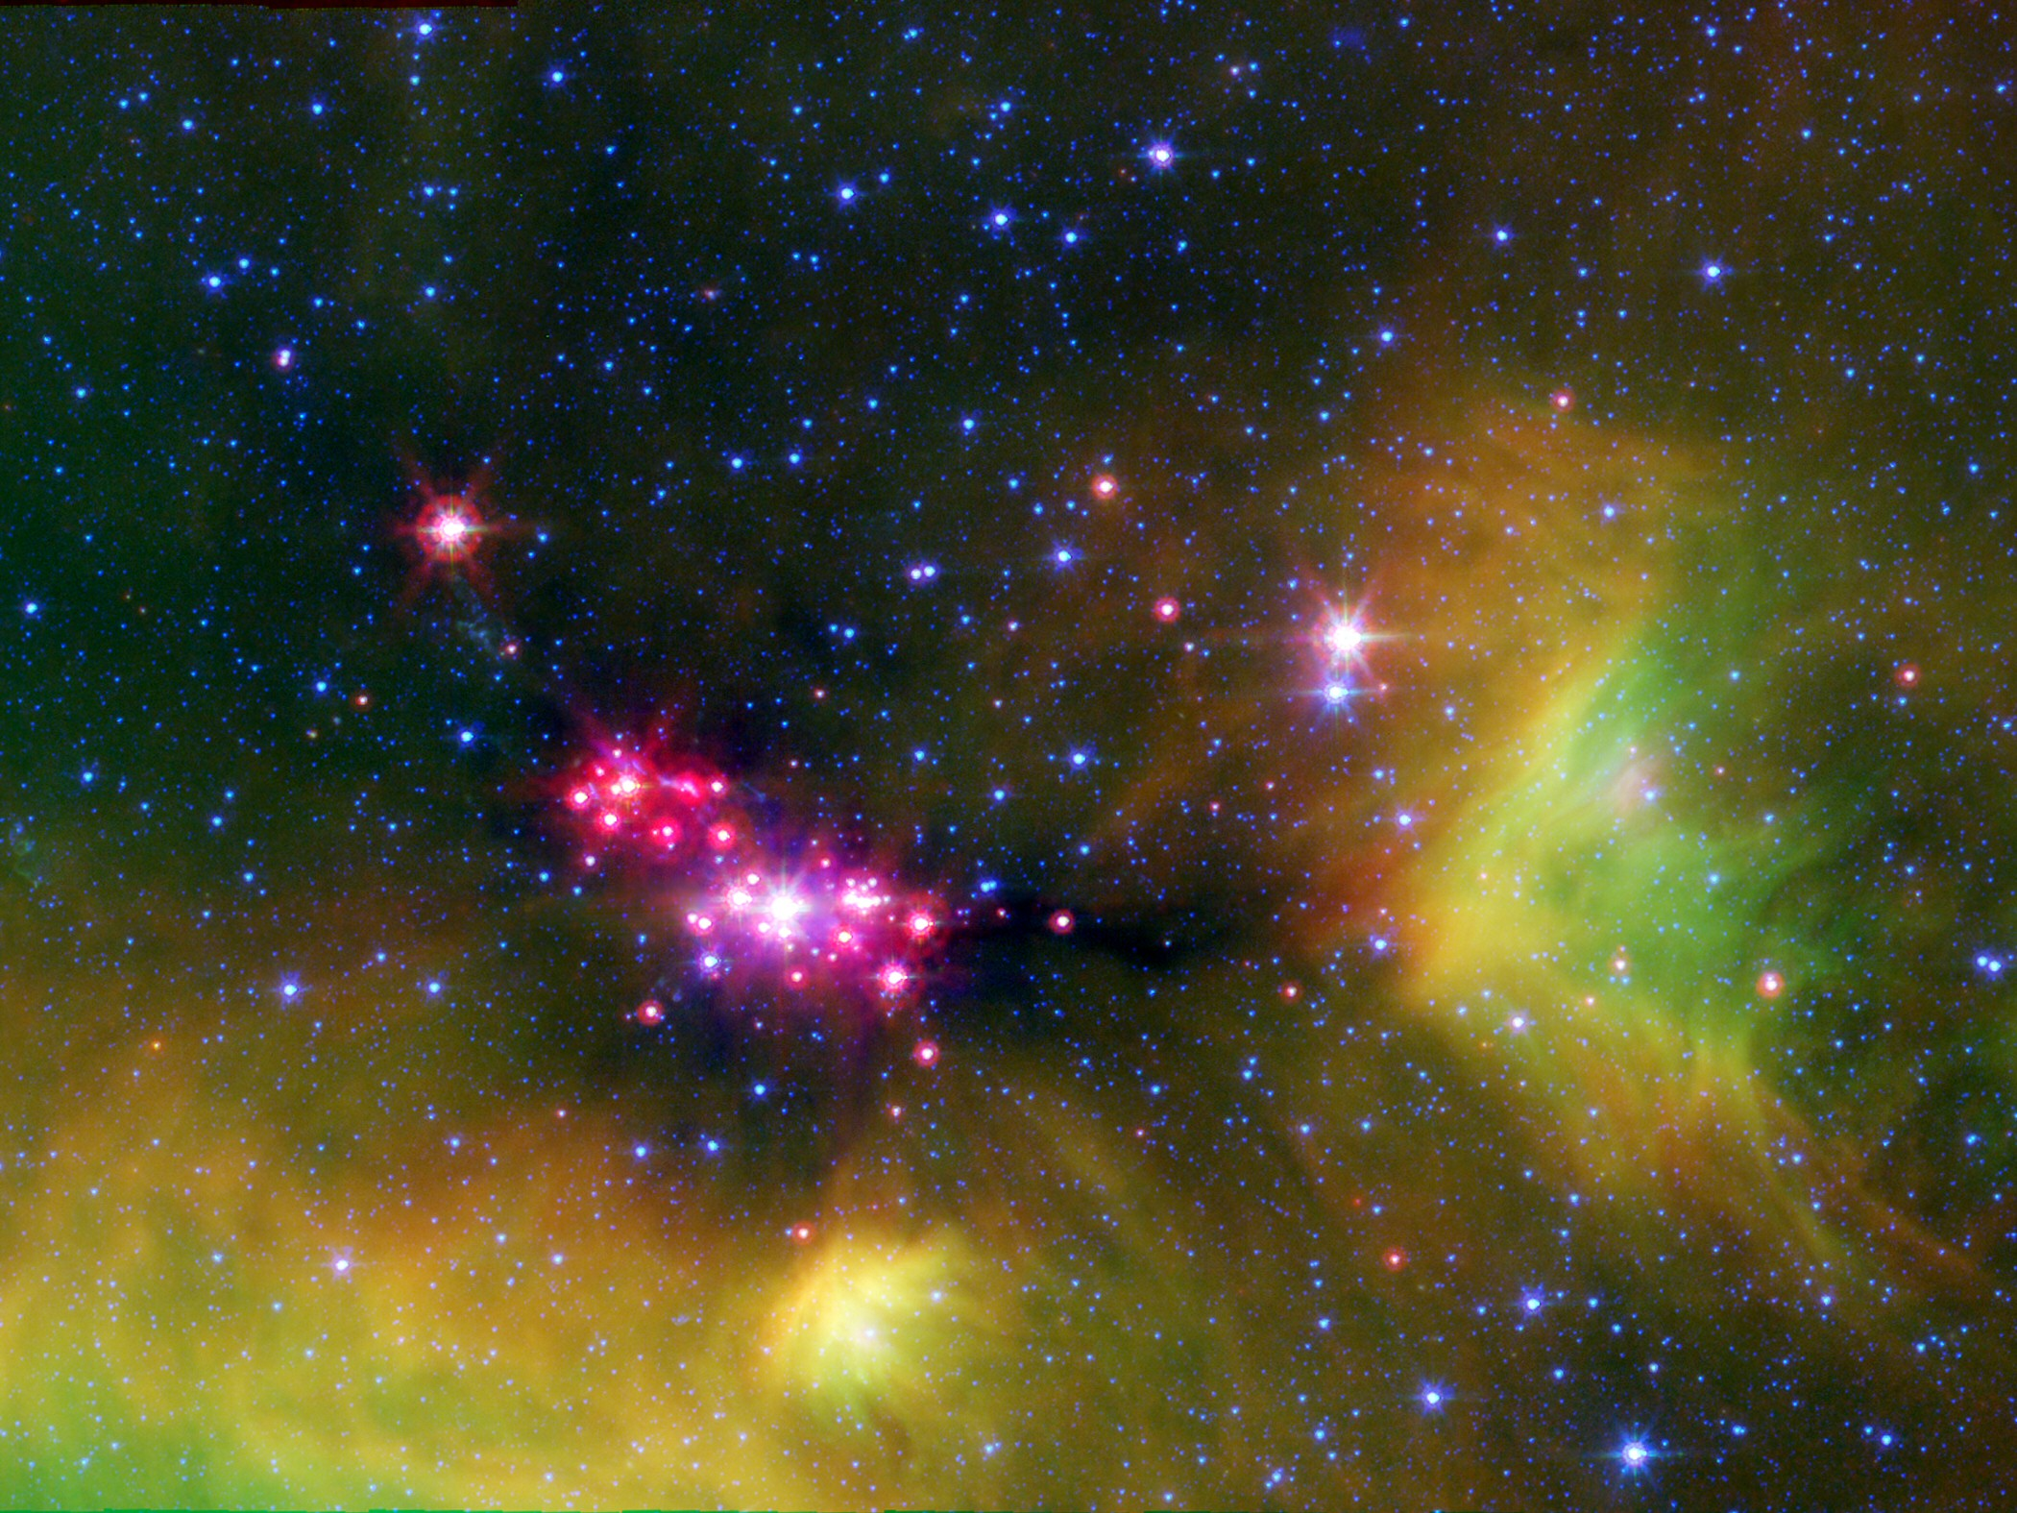
Serpens SMM1 & SMM4:
HDO & H₂O
Joseph Mottram
on behalf of Tobias Albertsson, Ewine van Dishoeck, Lars Kristensen, Markus Schmalzl & Ruud Visser

Slide 2


The spectra
Broad emission not seen in HDO & H₂¹⁸O
SMM4 shows redshifted absorption

Slide 3


The spectra
Broad emission not seen in HDO & H₂¹⁸O
SMM4 shows redshifted absorption

Slide 4
Absorbing Column Density
Source | N (H₂O) | N (HDO) | HDO/H₂O | N (H₂) (10<T<100K)
SMM1 | 5x10¹⁵ | 1x10¹³ | 0.2% | 3.3x10²³
SMM4 | <1x10¹⁵ | 2.5x10¹² | <0.4% | 3.9x10²³
Assuming that H₂O and HDO probe the same column

Slide 5


Slide 6
30

Slide 7


Slide 8
Water abundance profile
Mottram et al., in prep
Simple chemistry provides much better fit to line profiles for NGC1333-IRAS4A

Slide 9
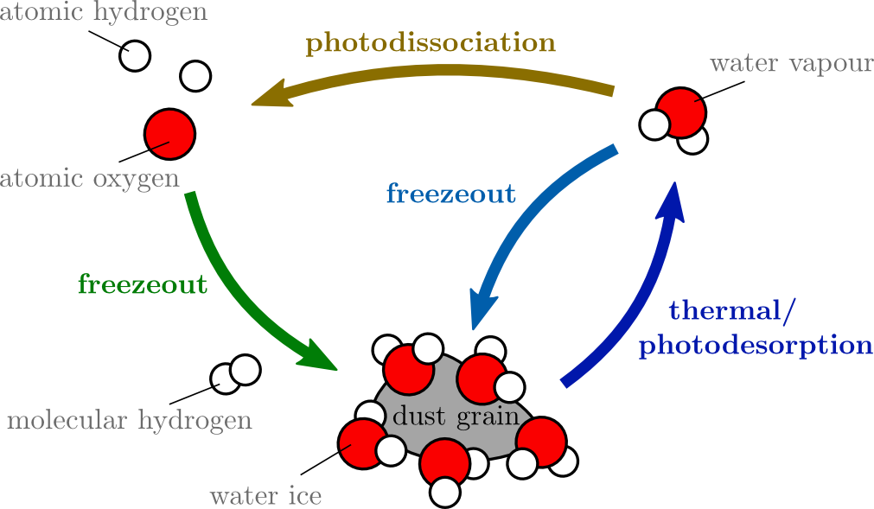
Simple Water Chemistry
Scheme considers only oxygen, water vapour & ice similar to Hollenback et al., 2009
Slope throughout cold (<100K) envelope due to density dependence of freezout
Schmalzl et al., in prep

Slide 10
Comparison with more complex chemical model
Simple abundance profile has broadly similar shape & currently better agreement with observations

Slide 11
Model for HDO/H₂O
Emission currently overproduced

Slide 12
Consistent for HDO
Constant HDO/H₂O of 0.005 used
Constrains inner infall radius

Slide 13
An infalling envelope model for SMM4
Envelope model struggles to reproduce shape and width of observations

Slide 14
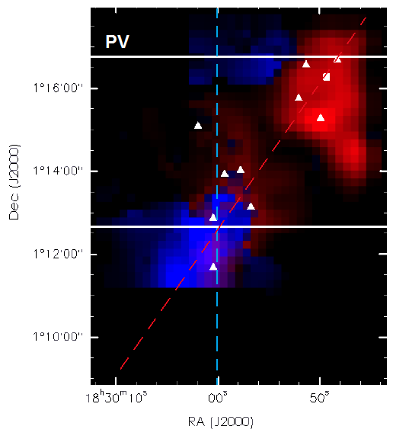
So what is happening?
Duarte-Cabral et al., ( 2011) suggest Serpens Main is actually two colliding clouds

Slide 15
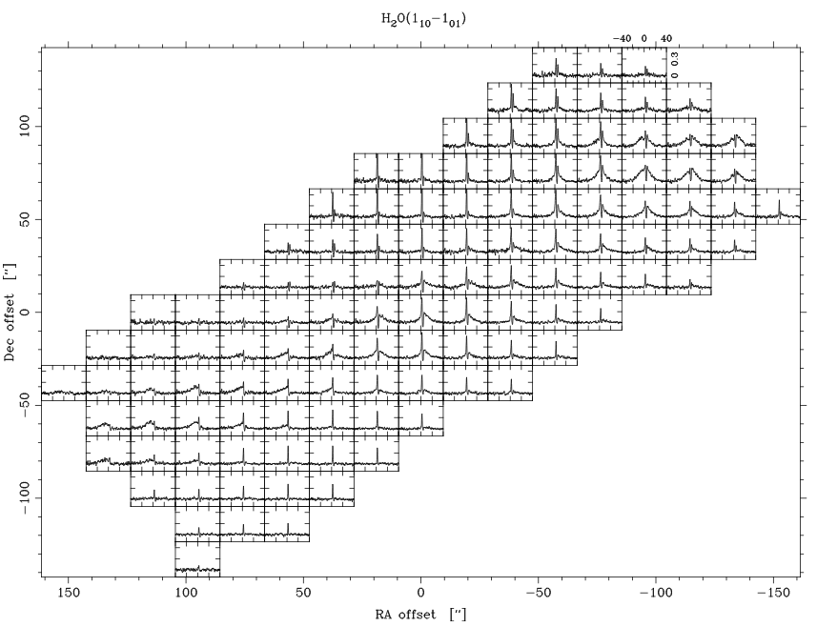
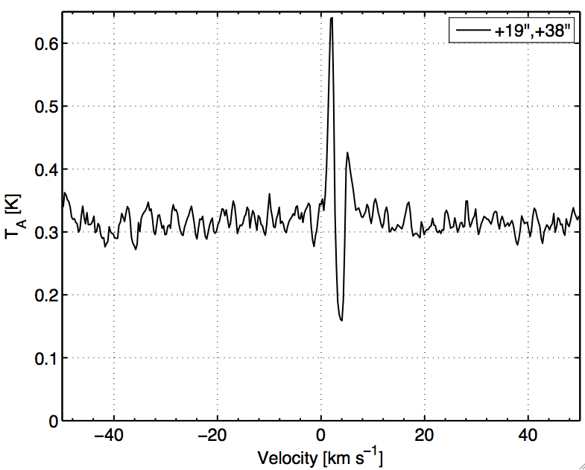
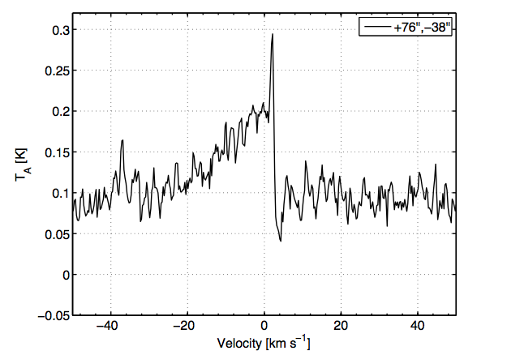
Similar effect seen towards VLA1623
Bjerkeli et al., 2012 see IPCs across whole
  H₂O Map

Slide 16
Similar for SMM1?
Yet to implement absorption against the outflow
Otherwise absorption must be at lower densities than consistent with envelope model

Slide 17

Any Questions?

