Slide 1
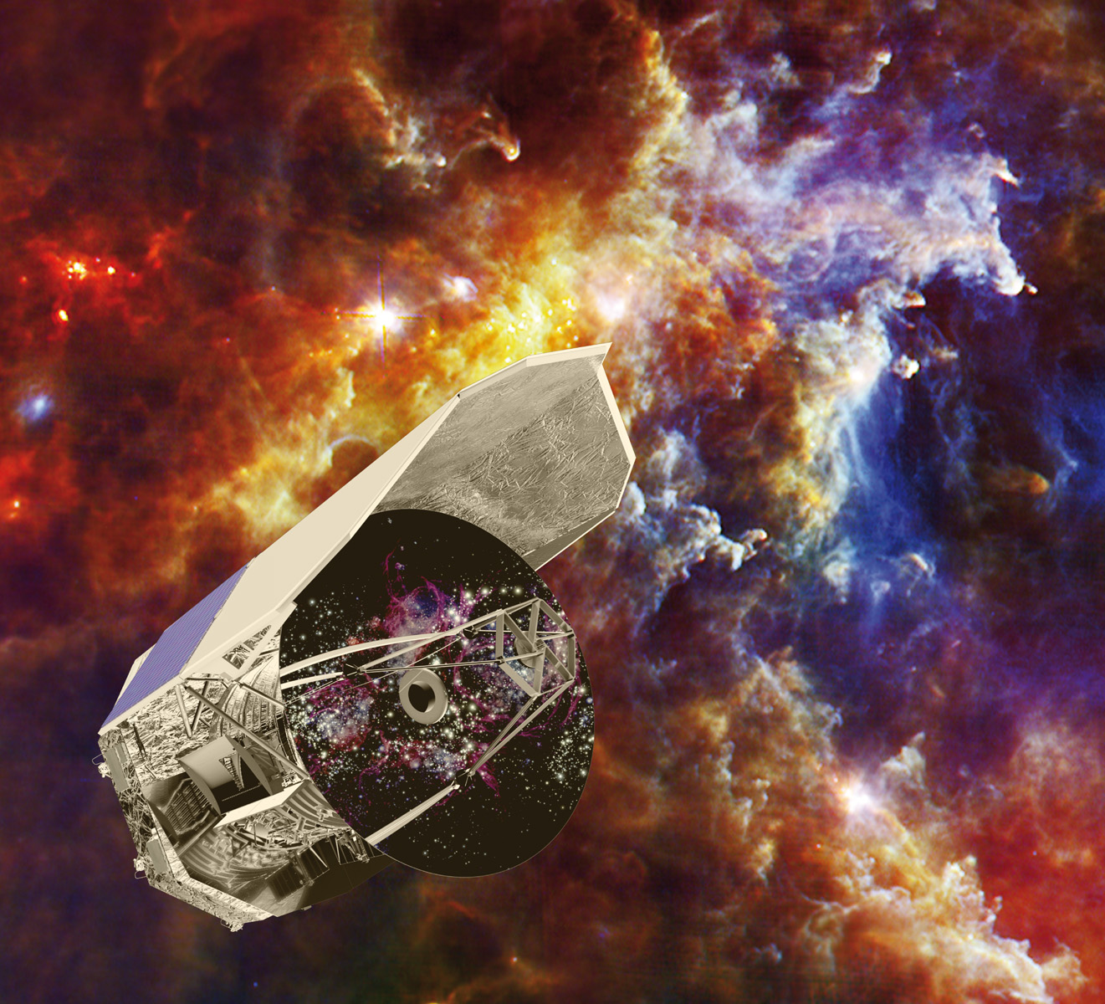
News from CHESS
Ana López Sepulcre
(on behalf of C. Ceccarelli)
HDO/H₂O workshop. Garching, 15 Jan 2013

Slide 2
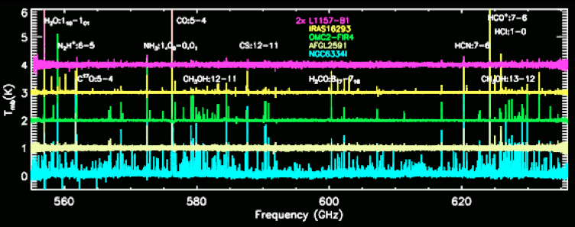
CHESS overview: Band 1b
Ceccarelli, C., Bacmann, A., Boogert, A. et al. 2010, A&A, 521, 22
Herschel-HIFI unbiased spectral surveys of a sample of star forming regions covering a range of masses and evolutionary phases
Rich emission/absorption spectrum

Slide 3
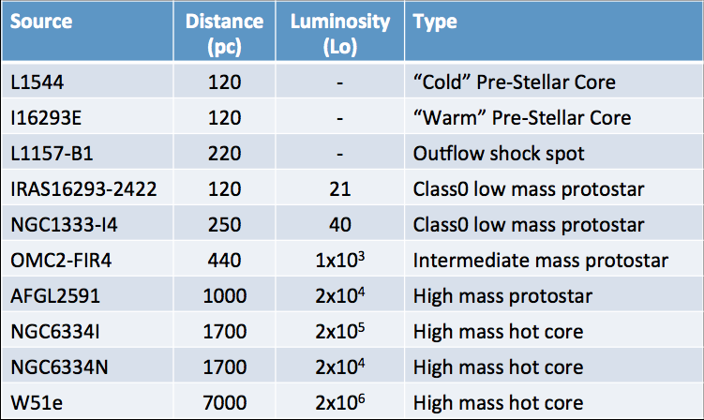
CHESS & HDO
Studies of water deuteration only for 2 sources so far
Rich emission/absorption spectrum

Slide 4
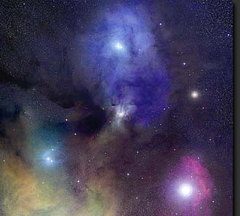
The low-mass protostar IRAS 16293-2422
IRAS16293-2422
solar type protostar
Schöier et al. 2002
Bottinelli et al. 2004
450μm
20”
B
A
d = 120 pc
2-M_{sun} ENVELOPE + BINARY SYSTEM +
a little of OUTFLOW in the HIFI BEAM (~36” @ 550GHz)
Dataset:
• CHESS HIFI spectrum (480-1900 GHz)
• IRAM+JCMT spectral surveys: TIMASSS (3-0.8 mm)
Notes:
Located in the rho Ophiucus molecular cloud; Two cores separated by 4 arcsec (480 AU): A and B (A could be a binary itself)
Audrey et al.: Assume all HDO comes from Core A, which is both more massive and stronger emitter as seen in HDO interferometric data from Jorgensen+2011
SCUBA image @ 450 mic
PdBI image at 1.3mm

Slide 5
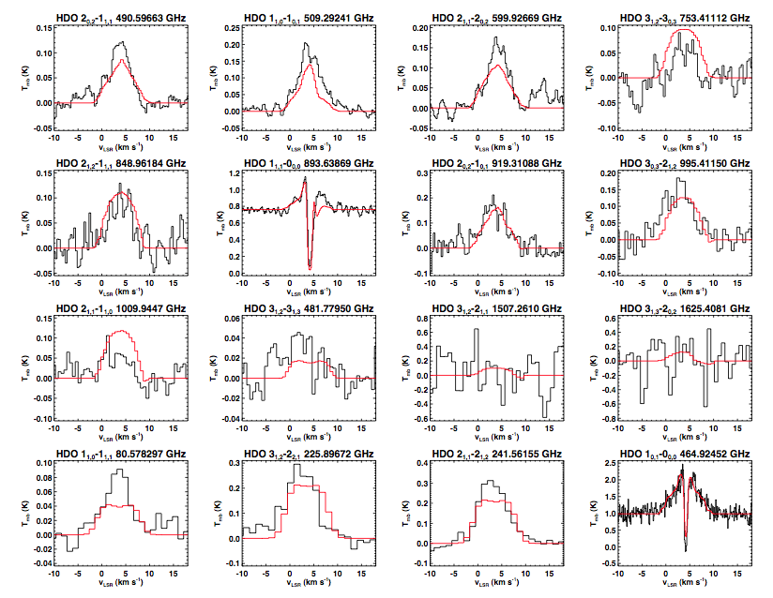
The low-mass protostar IRAS 16293-2422
16 HDO lines
E_{up} = 22 – 170 K
15 H₂¹⁸O lines
E_{up} = 53 – 450 K
Coutens et al. 2012,
A&A, 539, 132
OBSERVED and MODELED HDO SPECTRA

Slide 6
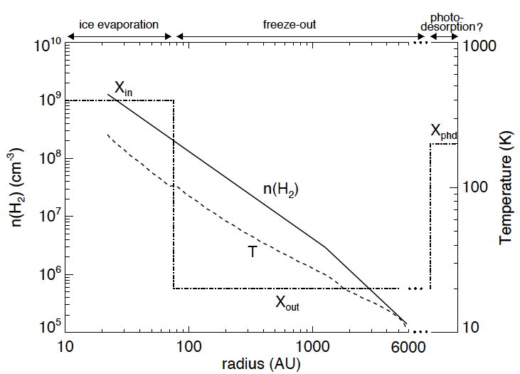
The low-mass protostar IRAS 16293-2422
Modelling: RATRAN code (Hogerheijde & van der Tak 2000)
Source structure from Crimier et al. (2010)
Χ_{in} = 1.7 x 10⁻⁷
Χ_{phd} = 0.6 – 2.4 x 10⁻⁸
HDO/H₂O ratio:
Inner: 3.4 %
Outer: 0.5 %
Abs layer: ~ 4.8 %
Χ_{in} = 8 x 10⁻¹¹
Coutens et al. 2012,
A&A, 539, 132
Notes:
HDO results

Slide 7
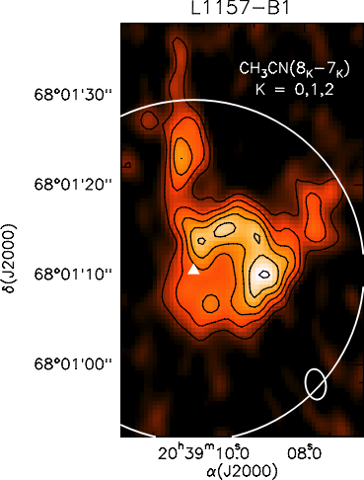
The outflow shock spot L1157-B1
PdBI (Codella et al. 2009)
Dataset:
• CHESS HIFI spectrum
(480-1900 GHz)
• IRAM spectral surveys
(3-0.8 mm)
CO 2-1
d = 250 pc
Notes:
CO from Bachiller+2001 ??

Slide 8
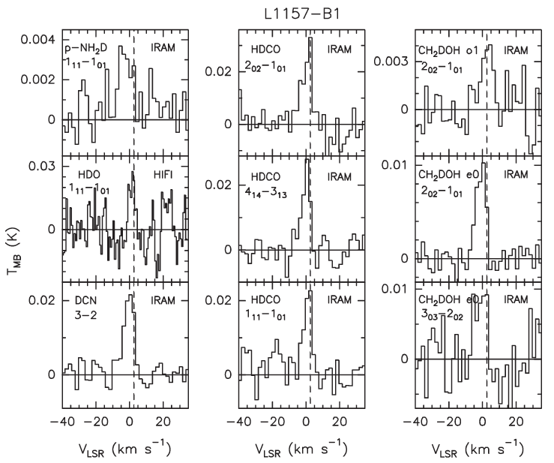
The outflow shock spot L1157-B1
HIFI:
HDO(1₁₁-1₀₁) line
p-H₂O(2₀₂-1₁₁) line
Column densities derived using LVG code (Ceccarelli et al. 2003)
HDO/H₂O ratio:
0.04 – 0.2 %
Codella et al. 2012, ApJL, 757, L9

Slide 9
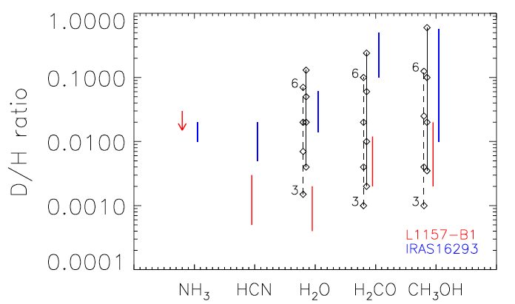
Comparison between the two sources
Codella et al. 2012, ApJL, 757, L9
IRAS 16293-2422: 0.5 - 5 %
L1157 - B1: 0.04 – 0.2 %%

Slide 10
THANK YOU
Notes:
CONCLUDE?

