Slide 1
Ice deuteration:
Models and observations to interpret the protostar history
V. Taquet, C. Ceccarelli, C. Kahane, A. López-Sepulcre
Institut de Planétologie et d'Astrophysique de Grenoble
P. Peters, D. Duflot, C. Toubin
Laboratoire de Physique des Lasers et des Matériaux, Lille
R. Neri
Institut de Radiastronomie Millimétrique, Grenoble
HDO 2013 workshop

Slide 2
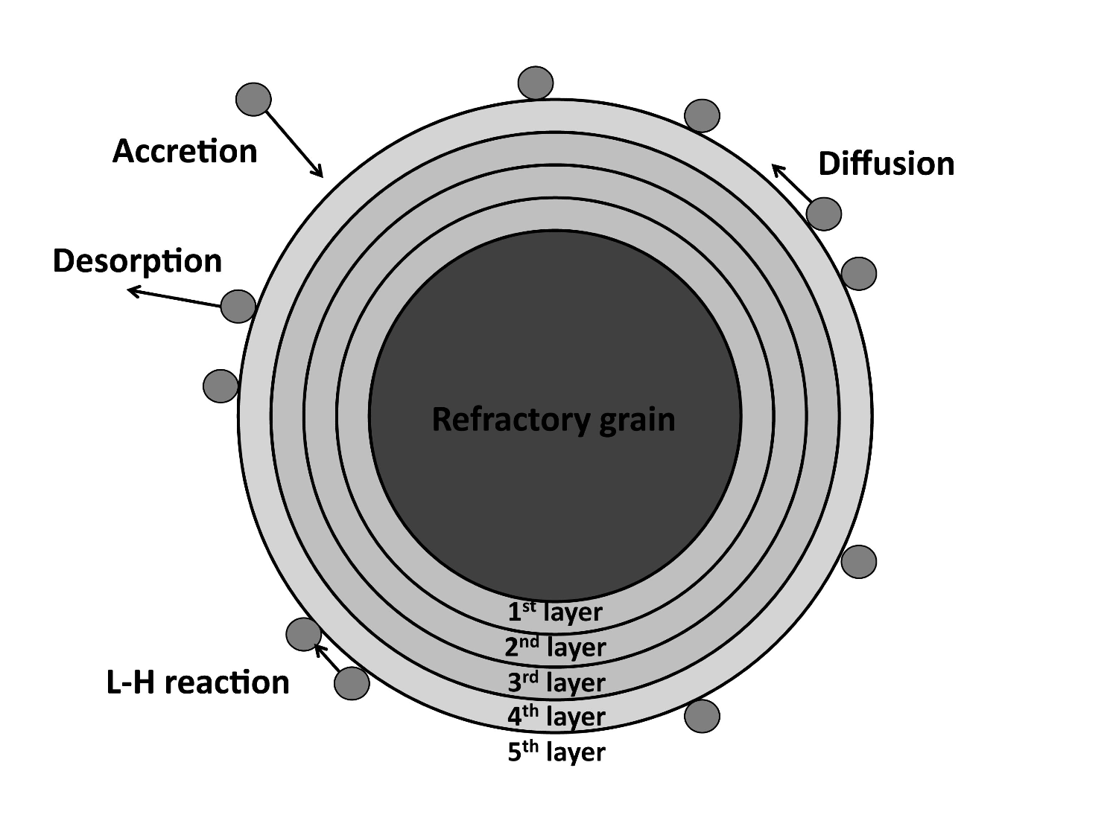
The GRAINOBLE model
1 - Model
2 - Predictions
3 - Observations
4 - Conclusions
Time-dependent gas-grain astrochemical model based on the rate equations (Hasegawa et al. 1992)
- gas phase processes
- gas-grain processes ➔ accretion and (thermal+non-thermal) desorption
- bimolecular and exothermic surface reactions
➔ Following surface experiments which show that cold ices are mostly inert (see Watanabe et al. 2003, 2004), Multilayer approach that:
- distinguishes the processes between surface/ bulk
- traps particles in the bulk
- saves the composition of each layer
➔ accurate for ice photolysis
Taquet, Ceccarelli, Kahane 2012a, A&A, 538, A42
Notes:
L-H reaction: Langmuir-Hinshelwood process -> 2 particles collide to form a new molecule, common mechanism
Desorption: thermal, CR induced, photolysis

Slide 3
The chemical network
1 - Model
2 - Predictions
3 - Observations
4 - Conclusions
Gas phase chemical network:
- complex network coming from the KIDA database for 7 elements
- deuterium chemistry (following Roberts et al. 2000, 2003, 2004)
- ortho and para spin states of H₂ and key ions (following Hugo et al. 2009)
Surface chemical network based on recent experimental works:
- deuterated water network from i) O (Dulieu+ 2010, Oba+ 2012),
ii) O₂ (Miyauchi+ 2008, Ioppolo+ 2010), iii) O₃ (Mokrane+ 2009)
- deuterated formaldehyde and methanol network
(Watanabe+ 2002, Nagaoka+ 2005, Hidaka+ 2009, Fuchs+ 2009)
- carbon dioxide network (Oba+ 2010, Ioppolo+ 2011, Raut+ 2011)
- wavelength-dependent UV photolysis on ices based on experimental works (Fayolle+ 2011) or MD simulations (Andersson+ 2008)
Notes:
Deuterium chemistry on H, H+, H2, H3+, HCO+, N2H+

Slide 4
Multiparameter approach
1 - Model
2 - Predictions
3 - Observations
4 - Conclusions
Several input parameters show a large range of values:
- Physical conditions vary with time/object
- Grain surface parameters follow distributions depending on grain/ice
- Uncertain key chemical parameters
➔ Model grid by varying the input parameter values:
study the influence of each parameter on the ice chemistry
Notes:
E_a(CO) = acivation barrier of the CO reactions (hydrogenation in 1st paper)
X(O) = atomic oxygen abundance (uncertain)
A_d = grain sizes
F_por = porosity, i.e. fraction of surface covered by pores; no adsorption/desorption allowed, only filled by diffusion on surface: found small impact on chemical composition
d_s = monolayer thickness: found small impact on chemical composition
E_d/E_b = Barrier energy against diffusion vs binding energy (barrier energy against desorption); range based on experiments

Slide 5
Chemical differentiation within ices
1 - Model
2 - Predictions
3 - Observations
4 - Conclusions
Ices are very heterogeneous and their chemical composition depends on the physical conditions
Translucent cloud region
n_{H} = 10⁴ cm⁻³
T = 15 K
A_{v} = 2 mag (➔ A_{v,obs} = 4 mag)
Water-rich ice (+ CO₂)
➔ consistent with Av-dependent ice observations (see Whittet et al. 2001, 2007)
Fractional composition in each layer
O-bearing species
Main isotopologues
Taquet, Peters, Kahane, Ceccarelli et al. 2013, A&A, in press
Notes:
translucent: (n_{H} = 10⁴ cm⁻³, T = 15 K, A_{v} = 2 mag)
dense core: n_{H} = 10⁵ cm⁻³, T = 10 K, A_{v} = 10 mag

Slide 6
Chemical differentiation within ices
1 - Model
2 - Predictions
3 - Observations
4 - Conclusions
Ices are very heterogeneous and their chemical composition depends on the physical conditions
Dense core region
n_{H} = 10⁵ cm⁻³
T = 10 K
A_{v} = 10 mag (A_{v,obs} = 20 mag)
CO-rich ice
(+ H₂O₂, H₂CO, CH₃OH)
➔ consistent with Av-dependent ice observations (see Whittet et al. 2007, 2011; Boogert et al. 2011)
Fractional composition in each layer
O-bearing species
Main isotopologues
Taquet, Peters, Kahane, Ceccarelli et al. 2013, A&A, in press
Notes:
translucent: (n_{H} = 10⁴ cm⁻³, T = 15 K, A_{v} = 2 mag)
dense core: n_{H} = 10⁵ cm⁻³, T = 10 K, A_{v} = 10 mag

Slide 7
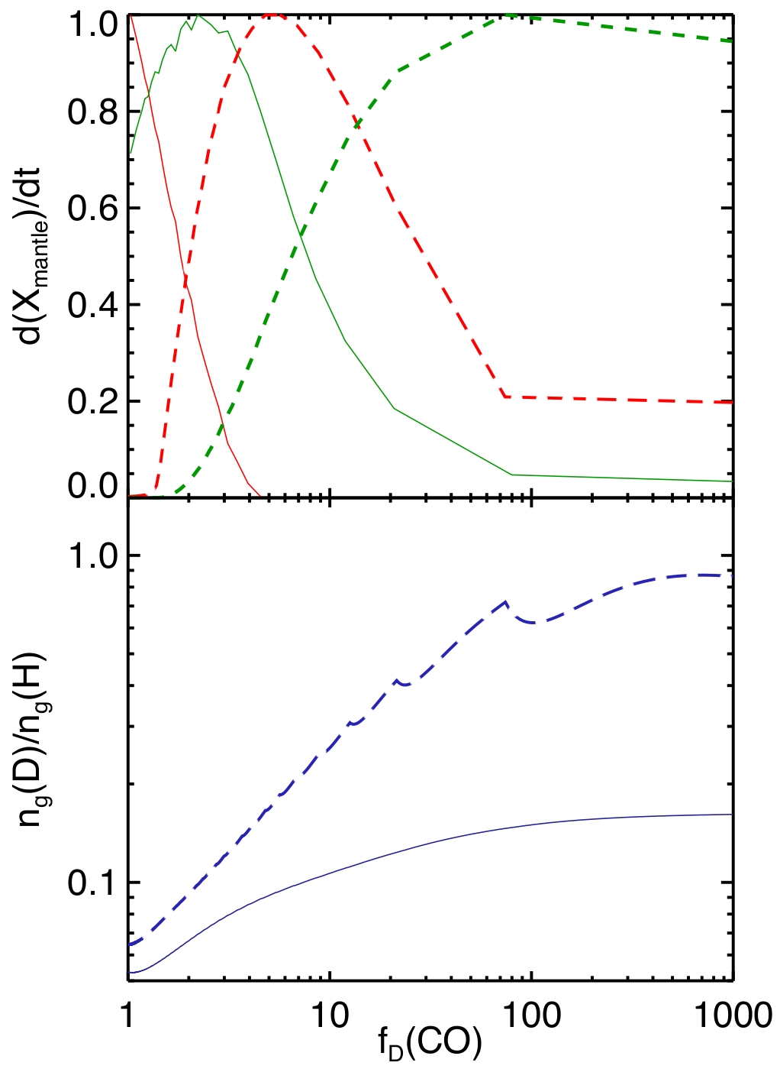
CO depletion and ice deuteration
1 - Model
2 - Predictions
3 - Observations
4 - Conclusions
Deuteration reactions in competition with reactions involving CO
HD
H₂D⁺
HD₂⁺, D₃⁺, D, ...
H₃⁺
Normalized formation rate
H₂CO
CO
HCO⁺
➔ CO depletion increases the deuteration
(see Roberts et al. 2003)
CH₃OH
Icy molecules (H₂O, H₂CO, CH₃OH) form
via addition reactions with H, D atoms
➔ Their deuteration depend on:
- the increase of the gaseous atomic [D]/[H]
- when they are formed
n_{H} = 5 10⁶ cm⁻³
Atomic [D]/[H]
n_{H} = 10⁵ cm⁻³
Taquet, Ceccarelli, Kahane 2012b, ApJL, 748, L3
CO depletion factor
Notes:
WHEN THEY ARE FORMED: Higher density → fewer H atoms landing on grains → fewer water, H2CO and CH3OH formed by hydrogenation → these form later in time
DENSITY: low density → important fraction (30%) of D already in atomic form → not affected by CO
high density → negligible fraction of D in atomic form → CO depletion increases H3+ + HD reaction, leading to atomic D (among others) → D/H increases
ALTOGETHER: deuterated H2O, H2CO and CH3OH are more abundant for larger densities (+ D/H), and later evolutionary stages (when more of the heavy molecules are formed)

Slide 8
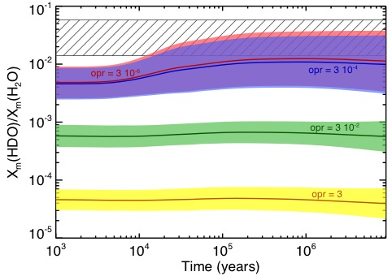
H₂ ortho/para ratio and ice deuteration
1 - Model
2 - Predictions
3 - Observations
4 - Conclusions
Ortho spin state of H₂ has a higher internal energy, allowing endothermic reactions to occur at low temperatures
➔ deuteration in the gas phase decreases with the opr(H₂)
The opr(H₂) decreases the water deuteration by several orders of magnitude
➔ stronger decrease than the standard deviations induced by all other parameters
Water deuteration for 4 opr(H₂) values and varying 6 other parameters
Taquet, Peters, Kahane, Ceccarelli et al. 2013, A&A, in press.

Slide 9
Ice formation in IRAS 16293
1 - Model
2 - Predictions
3 - Observations
4 - Conclusions
Water deuteration is reproduced for:
- a low H₂ o/p (< 3 10⁻⁴)
- a large range of n_{H} (8 10³ < n_{H} < 3 10⁵ cm⁻³)
- temperatures between 10 and 20 K
Formaldehyde and methanol deuteration are reproduced for:
- higher densities (> 5 10⁵ cm⁻³)
- lower temperatures (≈ 10 K)
➔ water forms first in low-density regions while formaldehyde and methanol are mainly formed in cold dark cores
[XD]/[XH]
[XD₂]/[XH]
solid: 10 K, dashed: 20 K
Taquet, Peters, Kahane, Ceccarelli et al. 2013, A&A, in press.

Slide 10
Water deuteration in low-mass protostars
1 - Model
2 - Predictions
3 - Observations
4 - Conclusions
Gas phase processes are not efficient enough to alter the deuteration after the ice evaporation seen in Class 0 protostars (Charnley+ 1997, André+ 2000, Osamura+ 2004)
➔ The deuteration observed in Class 0 protostars reflects the formation in ices
HDO/H₂O abundance ratio in Class 0 protostars:
tracer of the water formation in the precursor cold phase
However, HDO/H₂O constrained only in a few low-mass protostars
➔ Only IRAS 16293 shows a value of the ratio; for other protostars lower/upper limits
Taquet, López-Sepulcre, Ceccarelli et al. 2013, ApJL, submitted

Slide 11
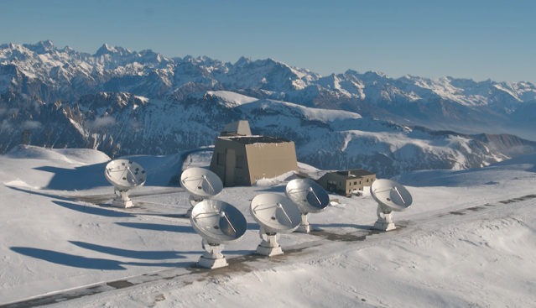
HDO in NGC 1333 IRAS 2A and 4A
1 - Model
2 - Predictions
3 - Observations
4 - Conclusions
➔ PdBI observations of the HDO 4_{2,2}-4_{2,3} transition (at 143 GHz) toward 2 low-mass protostars: NGC1333-IRAS2A and -IRAS4A
➔ High angular resolution (2’’): estimation of the emission coming from the warm quiescent envelope
Taquet, López-Sepulcre, Ceccarelli et al. 2013, ApJL, submitted

Slide 12
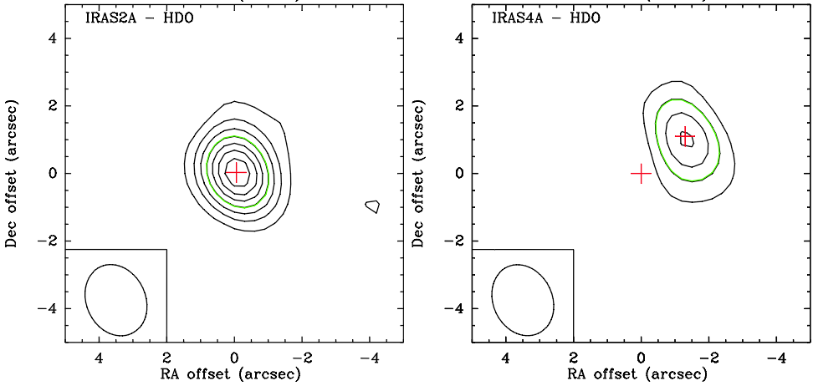
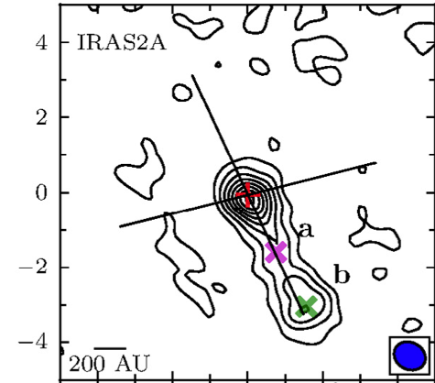
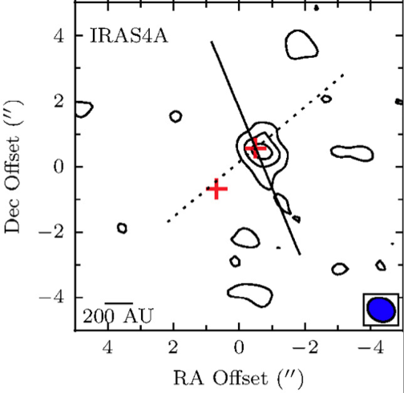
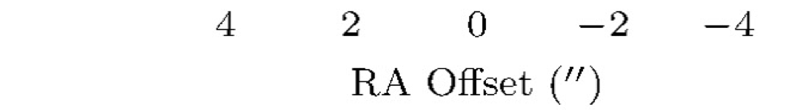
HDO in NGC 1333 IRAS 2A and 4A
1 - Model
2 - Predictions
3 - Observations
4 - Conclusions
Comparison of our observations with PdBI H₂¹⁸O observations by Persson et al. (2012):
➔ Most of the HDO and H₂¹⁸O emissions originate from the same quiescent envelope
Taquet, López-Sepulcre, Ceccarelli et al. 2013, ApJL, submitted

Slide 13
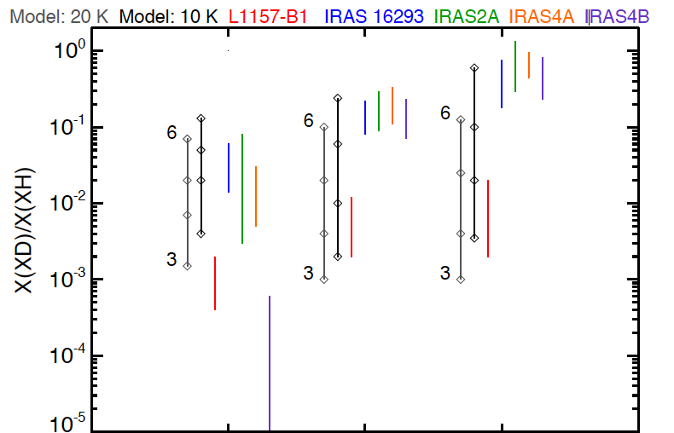
HDO in NGC 1333 IRAS 2A and 4A
1 - Model
2 - Predictions
3 - Observations
4 - Conclusions
LVG analysis of these emissions combined with single-dish observations of IRAS2A (Liu et al. 2011):
6 x 10⁵ < n_{H} < 10⁸ cm⁻³
T_{kin} = 75-80 K
θ = 0.4 "
➔ 5 x 10¹⁷ < N(HDO) < 10¹⁹ cm⁻²
Depending on the physical case,
- HDO/H₂O = 0.3 – 8 % in IRAS2A
- HDO/H₂O = 0.5 – 3 % in IRAS4A
H₂O
H₂CO
CH₃OH
Taquet, López-Sepulcre, Ceccarelli et al. 2013, ApJL, submitted

Slide 14
Conclusions & Perspectives
1 - Model
2 - Predictions
3 - Observations
4 - Conclusions
✓ The multilayer approach shows that ices are heterogeneous
➔ in good agreement with A_{v}-dependent ice observations
✓ The deuteration of water is explained by recent chemical networks
✓ The deuteration is very sensitive to the physical conditions
➔ trace the physical and chemical history of observed protostars
• Study of the multilayer formation and deuteration of ices with evolving physical conditions
• Use the deuteration to probe the formation pathways of Complex Organic Molecules

Slide 15
Thank you
Spitzer image of the
NGC1333 star-forming region

Slide 16
Interstellar grains and chemical complexity
1 - Introduction
2 - Model
3 - Predictions
4 - Observations
5 - Conclusions
Molecular clouds:
- simple molecules
- first ices (H₂O, CO₂)
≈ 10⁵ yr
≈ 10⁵ yr
≈ 10⁶-10⁷ yr
Prestellar cores:
- CO freeze-out
- other organic ices
Protostellar envelopes:
- COMs formation
- ice sublimation
Grains:
- size < 0.5 μm
- M_{d}/M_{g} = 1 %
- X_{d} = 10⁻¹²
Adapted from the review by Herbst & van Dishoeck (2009)

Slide 17
Deuteration in prestellar cores
1 - Introduction
2 - Model
3 - Predictions
4 - Observations
5 - Conclusions
Deuterium fractionation: Abundance ratio between an hydrogenated species and its deuterated isotopologue including D atom(s)
Ex: water ➔ HDO/H₂O or D₂O/H₂O
High deuteration is observed for various species in prestellar cores:
Molecular clouds
Cosmic D/H reservoir: 10⁻⁵
(Linsky 2003)
Prestellar cores
see Ceccarelli et al. (2007); Bacmann et al. (2007)

Slide 18
Deuteration in Class 0 protostars
1 - Introduction
2 - Model
3 - Predictions
4 - Observations
5 - Conclusions
Very high molecular deuteration is observed in Class 0 protostars:
➔ Why do the grain surface molecules show different fractionations ?
Gas phase processes are not efficient enough to alter the deuteration after the ice evaporation seen in Class 0 protostars
(Charnley+ 1997, André+ 2000, Osamura+ 2004)
➔ The deuteration observed in Class 0 protostars reflects the formation in ices
Simple deuteration
Double deuteration
Triple deuteration
From Taquet et al. (2012, in press)
Notes:
Measurement of deuteration reflect formation epoch in ices because no time to change in gas phase → observations necessary. Here water
Each molecule shows a specific fractionation.
ex: water shows a lower deuteration (HDO/H2O=3%) than formaldehyde and methanol (up to 60%)

Slide 19
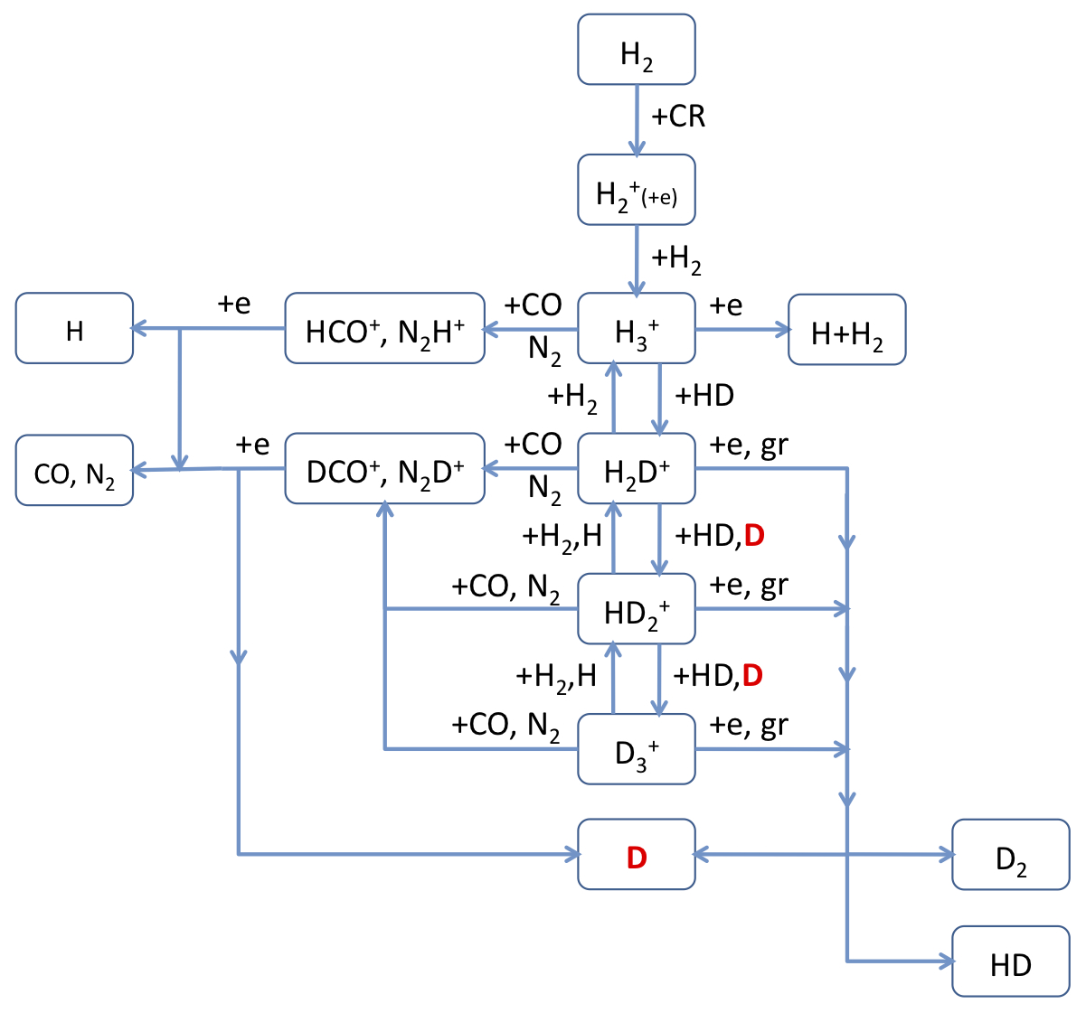
Deuterium chemistry
1 - Introduction
2 - Model
3 - Predictions
4 - Observations
5 - Conclusions
The deuteration reactions are in competition with reactions involving CO ➔ its depletion increases their reactivity
Model predictions computed by Roberts et al. (2004) with a gas phase model for n_{H} = 2 10⁶ cm⁻³, T = 10 K
Gas phase deuterium network

Slide 20
An example: the methanol network
1 - Introduction
2 - Model
3 - Predictions
4 - Observations
5 - Conclusions
Chemical network based on recent experimental studies:
- Hydrogenation of CO
(Watanabe+ 2002, 2004, 2006, Fuchs+ 2009)
- H₂CO deuteration via addition/abstraction reactions
(Hidaka+ 2009)
- CH₃OH deuteration via addition/abstraction reactions
(Nagaoka+ 2005, 2007)
Chemical network proposed by Watanabe & Kouchi (2008), Hidaka et al. (2009)

Slide 21
Formation and deuteration of water ice
1 - Introduction
2 - Model
3 - Predictions
4 - Observations
5 - Conclusions
Chemical network based on recent experimental works:
- Hydrogenation of atomic O
(Dulieu+ 2010, Jing+ 2011, Oba+ 2012)
- Hydrogenation of O₂, O₃
(Miyauchi+ 2008, Ioppolo+ 2008, Mokrane+ 2009, Cuppen+ 2010, Romanzin+ 2011)
- Deuteration of O, O₂
(Miyauchi+ 2008, Matar+ 2008, Oba+ 2012)

Slide 22
Reaction probabilities
1 - Introduction
2 - Model
3 - Predictions
4 - Observations
5 - Conclusions
Some key reactions show activation energy barriers
- In previous models, reaction probability computed assuming a rectangular energy barrier with a width arbitrary fixed to 1 A
➔
TS
- The Eckart model is introduced for all the reactions, from quantum gas phase calculations
➔ fit an approximate PES
➔ compute an accurate reaction probability
ex: H₂O₂ + H ➔ H₂O + OH
P_{r,square} = 1.2 10⁻⁸; P_{r,Eckart} = 1.4 10⁻⁷
a = 1 A
E_{a}
Energy
Reactants
Products
Reaction coordinate
Taquet, Peters, Kahane, Ceccarelli et al. 2012c, A&A, in press.
Notes:
Probability of reaction via quantum tunneling through the energy barrier

Slide 23
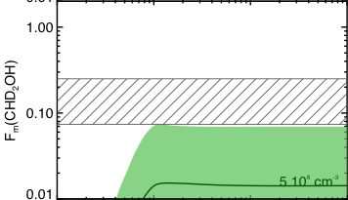
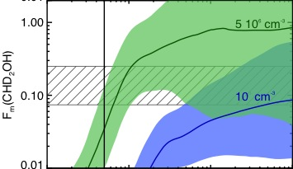
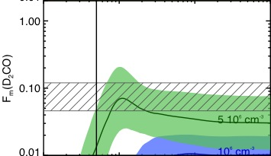
Abstraction reactions and formaldehyde/methanol deuterations
1 - Introduction
2 - Model
3 - Predictions
4 - Observations
5 - Conclusions
Abstraction reactions ➔ needed to reproduce the high observed H₂CO and CH₃OH deuterations
Addition reactions only
Addition + abstraction reactions
Observations
[CHD₂OH]/[CH₃OH]
[CHD₂OH]/[CH₃OH]
[D₂CO]/[H₂CO]
[D₂CO]/[H₂CO]
Taquet, Ceccarelli, Kahane 2012b, ApJL, 748, L3

Slide 24
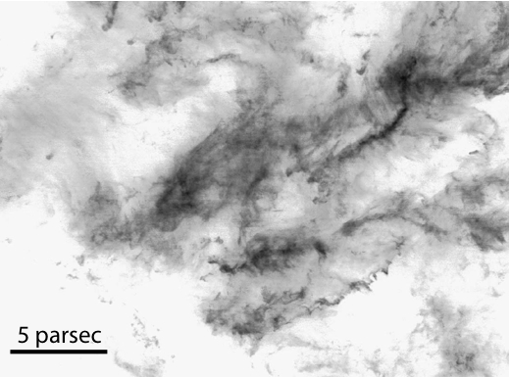
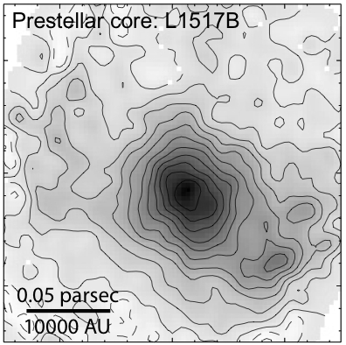
The formation of Sun-like stars
Low-mass protostars usually form in cold dark clouds, also called molecular clouds
Densities n_{H}: 10³ – 10⁴ cm⁻³
Temperature T: 10 – 30 K
Taurus Molecular Cloud seen in ¹³CO J=1-0 emission (Goldsmith et al. 2008)

Slide 25
Interstellar grains and chemical complexity
Infrared, sub-millimetric, and millimetric observations have revealed a chemical evolution with the evolutionary stage of stars
➔ In spite of their tiny sizes (< 0.5 μm), and their low abundances (1% in mass, < 10⁻¹² in abundances), interstellar grains play a crucial role in this chemical evolution

Slide 26
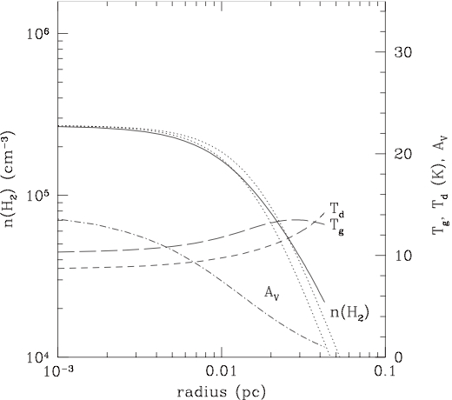
The formation of Sun-like stars
Cold dark cores form via the progressive accumulation of matter:
1.2 mm continuum map of L1517B (Tafalla et al. 2004)
Density, temperature and A_{v} structure computed by Galli et al. (2002)

Slide 27
The formation of Sun-like stars
A protostar borns at the center and starts to warm-up its envelope
Gravitational collapse
and protostar birth
1.3 mm continuum map of
IRAS 16293 (Bottinelli et al. 2004)
Density and temperature structures derived by Crimier et al. (2010)

Slide 28
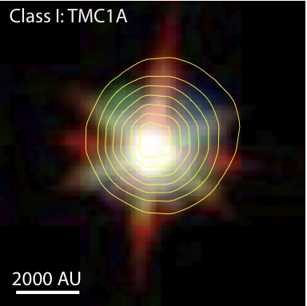
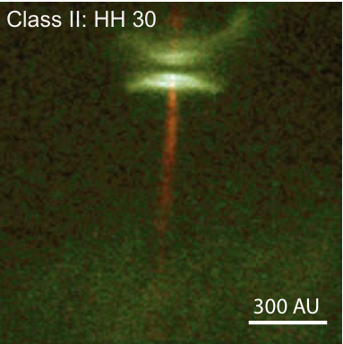
The formation of Sun-like stars
Envelope progressively accreted by the protostar
Almost of spherical envelope
Disk formation
Bipolar outflows
Evolved disk
Hubble website
di Francesco et al. (2008)
Formation of planetesimals, debris disks, and then planetary sytems
Boley et al. (2012)

Slide 29
Deuteration: why bothering ?
1 - Introduction
2 - Model
3 - Predictions
4 - Observations
5 - Conclusions
Molecular clouds:
- cosmic D/H ≈ 10⁻⁵
Prestellar cores:
- deuteration increase
Protostellar envelopes:
- superdeuteration
Solar System:
- deuteration probes its molecular origin
- deuteration probes Earth's water origin
Adapted from the review by Herbst & van Dishoeck (2009)

Slide 30
Deuteration: why bothering ?
1 - Introduction
2 - Model
3 - Predictions
4 - Observations
5 - Conclusions
Molecular deuteration refers to the abundance ratio between a hydrogenated species and its deuterated isotopologue, including one (or several) deuterium atoms
ex: water ➔ HDO/H₂O
Deuteration can probe the physical conditions at the moment of formation of specific molecules and their eventual reprocessing
➔ Investigate the origin of the molecular content in the Solar System by comparing the deuteration in the ISM and Solar System bodies (comets/meteorites)
➔ Evaluate the contribution of comets for transferring water in Earth's oceans by comparing the water deuteration on the Earth and in comets

Slide 31
Porous versus non-porous grain
Pores trap volatile species (H atoms) increasing their abundances
➔ slightly increase the formation of main hydrogenated species
Absolute abundances for a reference model (n_{H} = 10⁵ cm⁻³, T = 15 K) and a small network.
Solid: smooth grain, dotted: porous grain.
Taquet, Ceccarelli, Kahane 2012 A&A, 538, A42

Slide 32
Abundance distributions
Thanks to the fast computation, large grids of models are run
➔ allow us to study the impact of each parameter on ice chemistry
ex: Abundance distributions for the old "bulk" (blue) and the new "multilayer" (red) approaches
➔ Range of 8 parameters is varied ≈ 18000 runs
➔ H₂O, H₂CO, CH₃OH abundances are lower with the multilayer approach but radicals can survive
Taquet, Ceccarelli, Kahane 2012 A&A, 538, A42

Slide 33
H₂ ortho/para ratio and ice deuteration
1 - Introduction
2 - Model
3 - Predictions
4 - Observations
5 - Conclusions
Ortho spin state of H₂ has a higher internal energy, allowing endothermic reactions to occur at low temperatures
➔ deuteration in the gas phase decreases with the opr(H₂)
The opr(H₂) decreases the water deuteration by several orders of magnitude
➔ stronger impact than the standard deviations induced by all other parameters
Water deuteration for 4 opr(H2) values and varying 6 other parameters .
Taquet, Peters, Kahane, Ceccarelli et al. A&A, submitted

Slide 34
Reaction probabilities
1 - Introduction
2 - Model
3 - Predictions
4 - Observations
5 - Conclusions
Some key reactions show activation energy barriers
- In previous models, reaction probability computed assuming a rectangular barrier with a width arbitrary fixed to 1 A
- The Eckart model is introduced
➔ fit an approximate PES
➔ accurate reaction probability
ex: H₂O₂ + H ➔ H₂O + OH
P_{r,square} = 1.2 10⁻⁸
P_{r,Eckart} = 1.4 10⁻⁷
Taquet, Peters, Kahane, Ceccarelli et al. 2012c, A&A, submitted

